Slide 1

Green finance and climate change – risks and opportunities
Hannah Routh, Partner, Deloitte China
VP and Special Adviser, Hong Kong Green Finance Association
Deloitte Sustainability & Climate Change | April 2019
德勤可持续发展与气候变化 | 2019年9月

Slide 2

Agenda
Background to ESG Investing and Trends
Focus on TCFD – Task Force for Climate Related Financial Disclosure Closing remarks and questions
Hannah Routh
合伙人, 风险咨询
德勤咨询
物理学硕士, 科学硕士
+852 21095158
hrouth@deloitte.com.hk

Slide 3
Background to ESG investing and trends

Slide 4
Responsible Investment / ESG Investing – an opportunity for value creation
ESG投资- 价值增长的机会
2012 Harvard & London Business School Study, The Impact of Corporate Sustainability on Organisational Processes and Performance
2012，哈佛大学&伦敦商学院， 企业可持续发展对组织过程和绩效的影响
2015 University of Oxford & Arabesque Partners Meta-study, How sustainability can drive financial performance
2015，牛津大学& Arabesque Partners, 可持续性如何推动财务业绩
2015 University of Hamburg & Deutsche Asset & Wealth Management Investment Meta-study, ESG and financial performance:
2015，德国汉堡大学与德意志资产及财富管理投资公司， ESG与财务业绩
2015 HKUST and Robeco, The role of governance relative to environmental and social factors in equity returns. (Benz et al)
2015， 香港科技大学& Robeco, 管治相对于环境和社会因素在股权回报中的作用
  90% of the studies show that sound sustainability standards lower the cost of capital
  90％的研究表明，健全的可持续标准降低了资本成本
80% of the studies show that stock price performance of companies is positively influenced by good sustainability practices
80％的研究表明积极可持续性实践对公司的股价有正面影响
70% greater effect on stock price in Asia compared to rest of world
与世界其他地区相比，亚洲股票价格上涨70％
ESG investing leads to lower cost of capital and higher returns
ESG投资可以降低资本成本并提高回报

Slide 5
What does Responsible Investment / ESG investing entail?
Negative screening
负面筛选
ESG 投资代表什么？
Responsible Investment 责任投资
Positive Screening
积极筛选
Environmental 环境
Social 社会
Governance 管治
Anti-bribery & corruption
反贿赂和腐败
Business ethics 商业道德
Grievance procedures 申诉程序
Governance of sustainability issues 可持续性问题的管治
Etc. 其他
Carbon emissions 碳排放
Consumer rights
消费者权益
Resources efficiency (i.e. energy, water etc.)
资源效率（即能源、水等）
Etc. 其他
Waste & hazardous materials management
废弃物和有害物质管理
Corporate philanthropy
企业慈善事业
Health, safety & wellbeing
健康与安全
Human capital management
人力资本管理
Human rights 人权
Etc. 其他
Board composition 董事会构成
Executive remuneration
行政薪酬
Ownership structure 所有权结构
Climate resilience
气候适应力
Discharges/ pollution
排放/污染
Biodiversity loss
丧失生物多样性
Labor 劳工
Norms-based Screening
基于规范的筛选
ESG Integration
ESG整合
Sustainability themed investing
可持续发展主题投资
Impact Investing
影响力投资
Corporate Engagement / Shareholder action
企业参与/股东行动

Slide 6
ESG Investing Spectrum
ESG投资范围
Traditional investing
传统投资
Negative screening
负面筛选
Positive screening
积极筛选
ESG Integration
Impact investing
影响力投资
Philanthropy
慈善事业
Competitive returns
竞争回报
ESG risk management
ESG风险管理
ESG opportunities
ESG机会
Maximum-impact solutions
最大影响解决方案
Seeks financial returns regardless of Environmental, Social and Governance (ESG) factors
不考虑环境，社会和管治（ESG）因素，只追求财务回报
Investments are screened out based on ESG risk
根据ESG风险筛选选投资
Sustainability factors and financial returns drive investment selection
可持续性因素和财务回报推动投资选择
Systematic and explicit inclusion of ESG factors in financial analysis
Social and environmental considerations take precedence over financial returns
社会和环境因素比财务回报优先
Financial returns disregarded in favor of social and environmental solutions
财务回报的忽视有利于社会和环境解决方案
Potential Screens
潜在的筛选
Tobacco 烟草
Alcohol 酒精
Weapons 武器
Gambling 赌博
Pornography 色情
Nuclear Energy 核能
Factors considered:
考虑的因素：
Carbon footprint碳足迹
Resources use资源使用
Waste reduction
减少浪费
Compensation 赔偿金
Product safety产品安全
Gender equality
性别平等
Potential value areas：
Climate change
气候变化
Resource efficiency
Food systems
食品系统
Support for:
支持：
Innovation & risk taking 创新和风险承担
Proof of concept / plots 概念验证
Enabling environments
扶持环境
Commercial 广告
Based on: Impact investing, A sustainable strategy for hedge funds, Deloitte Centre for Financial Services
参考：影响力投资，对冲基金的可持续战略，德勤金融服务中心

Slide 7
Growth of Responsible Investment / ESG Investing Assets
ESG / 负责任投资资产的增长
Global ESG assets by region 按地区划分的全球ESG资产
Global Sustainable Investment Alliance 2016 report
2016年国际可持续投资联盟报告
Global sustainable investment increased by 25% from 2014-2016 to $22.8 trillion USD
全球可持续投资从2014年 - 2016年增加了25％，达到22.8万亿美元
Highest growth in Japan and Australia / New Zealand
日本和澳大利亚 / 新西兰的增长率最高
欧洲
美国
加拿大
澳大利亚/新西兰
亚洲（日本除外）
日本
欧洲
美国
加拿大
澳大利亚/新西兰
Growth of ESG assets by region 2014-2016, in USD billions 2014 - 2016年按地区划分的ESG资产增长，以十亿美元计算
亚洲（日本除外）
日本

Slide 8
Overview of sustainable investing strategies in Europe
From: European SRI Study 2018, Eurosif

Slide 9
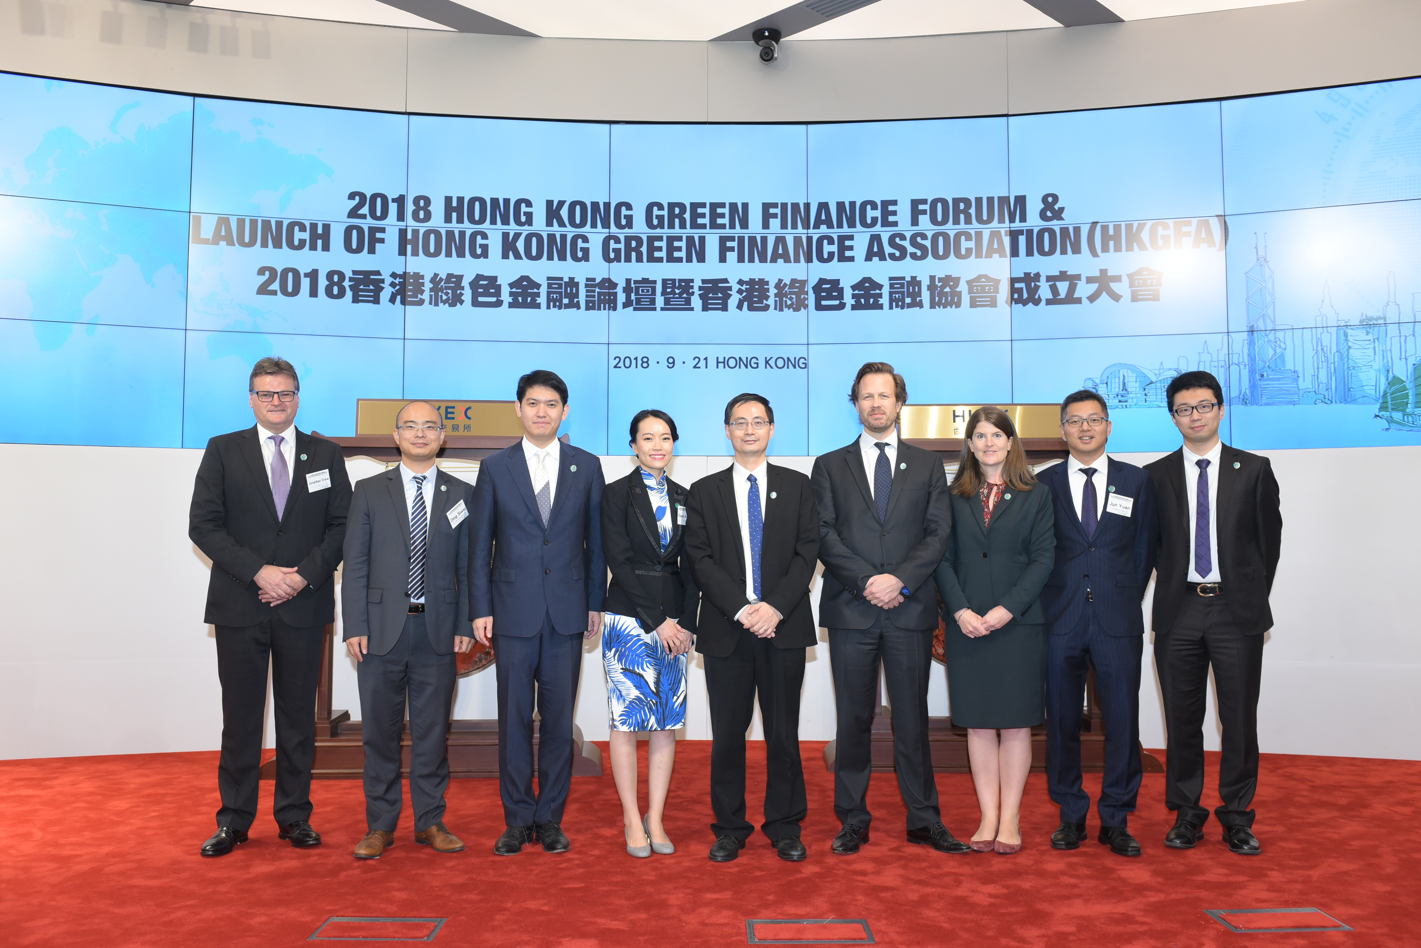
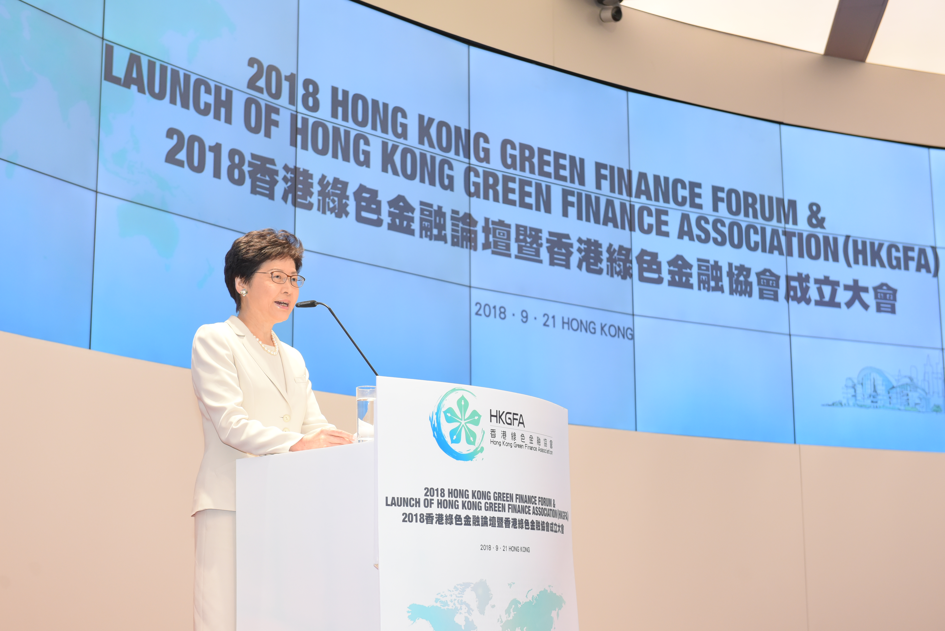

Hong Kong Green Finance Association (HKGFA) launched in September 2018

Slide 10
Financial Services Development Council (FSDC) publication
ESG Strategy for Hong Kong
Key Recommendations:
Government leadership on ESG integration
Hong Kong Monetary Authority – ESG requirements for external managers
Mandatory Provident Fund Schemes Authority to incorporate ESG standards
Securities and Futures Commission to strengthen emphasis on ESG
Hong Kong Stock Exchange to strengthen emphasis for both listing applicants and listed companies

Slide 11
Climate Change Risk

Slide 12
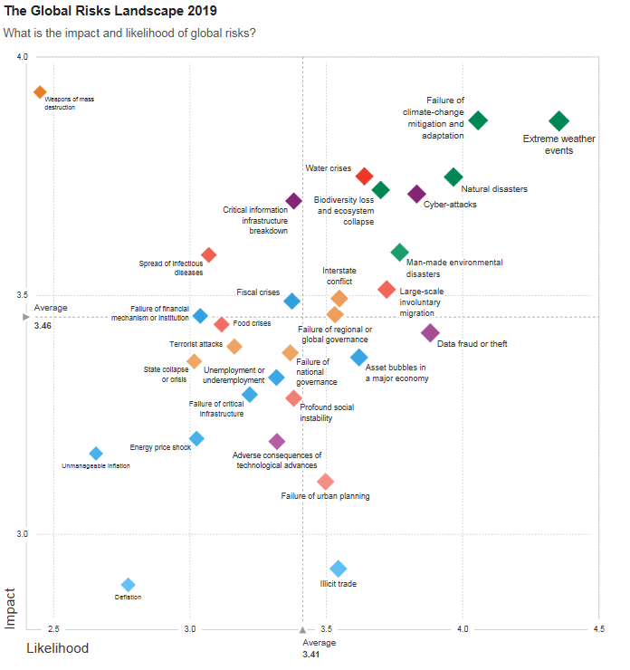
Climate Change – the greatest risk facing the world?
*
Top 10 risks in terms of Likelihood
Extreme weather events Failure of climate-change mitigation and adaptation Natural disasters Data fraud or theft Cyberattacks Man-made environmental disasters Large-scale involuntary migration Biodiversity loss and ecosystem collapse Water crises Asset bubbles in a major economy
Top 10 risks in terms of Impact
Weapons of mass destruction Failure of climate-change mitigation and adaptation Extreme weather events Water crises Natural disasters Biodiversity loss and ecosystem collapse Cyberattacks Critical information infrastructure breakdown Man-made environmental disasters Spread of infectious disease
Source: World Economic Forum Global Risks Perception Survey 2018–2019

Slide 13
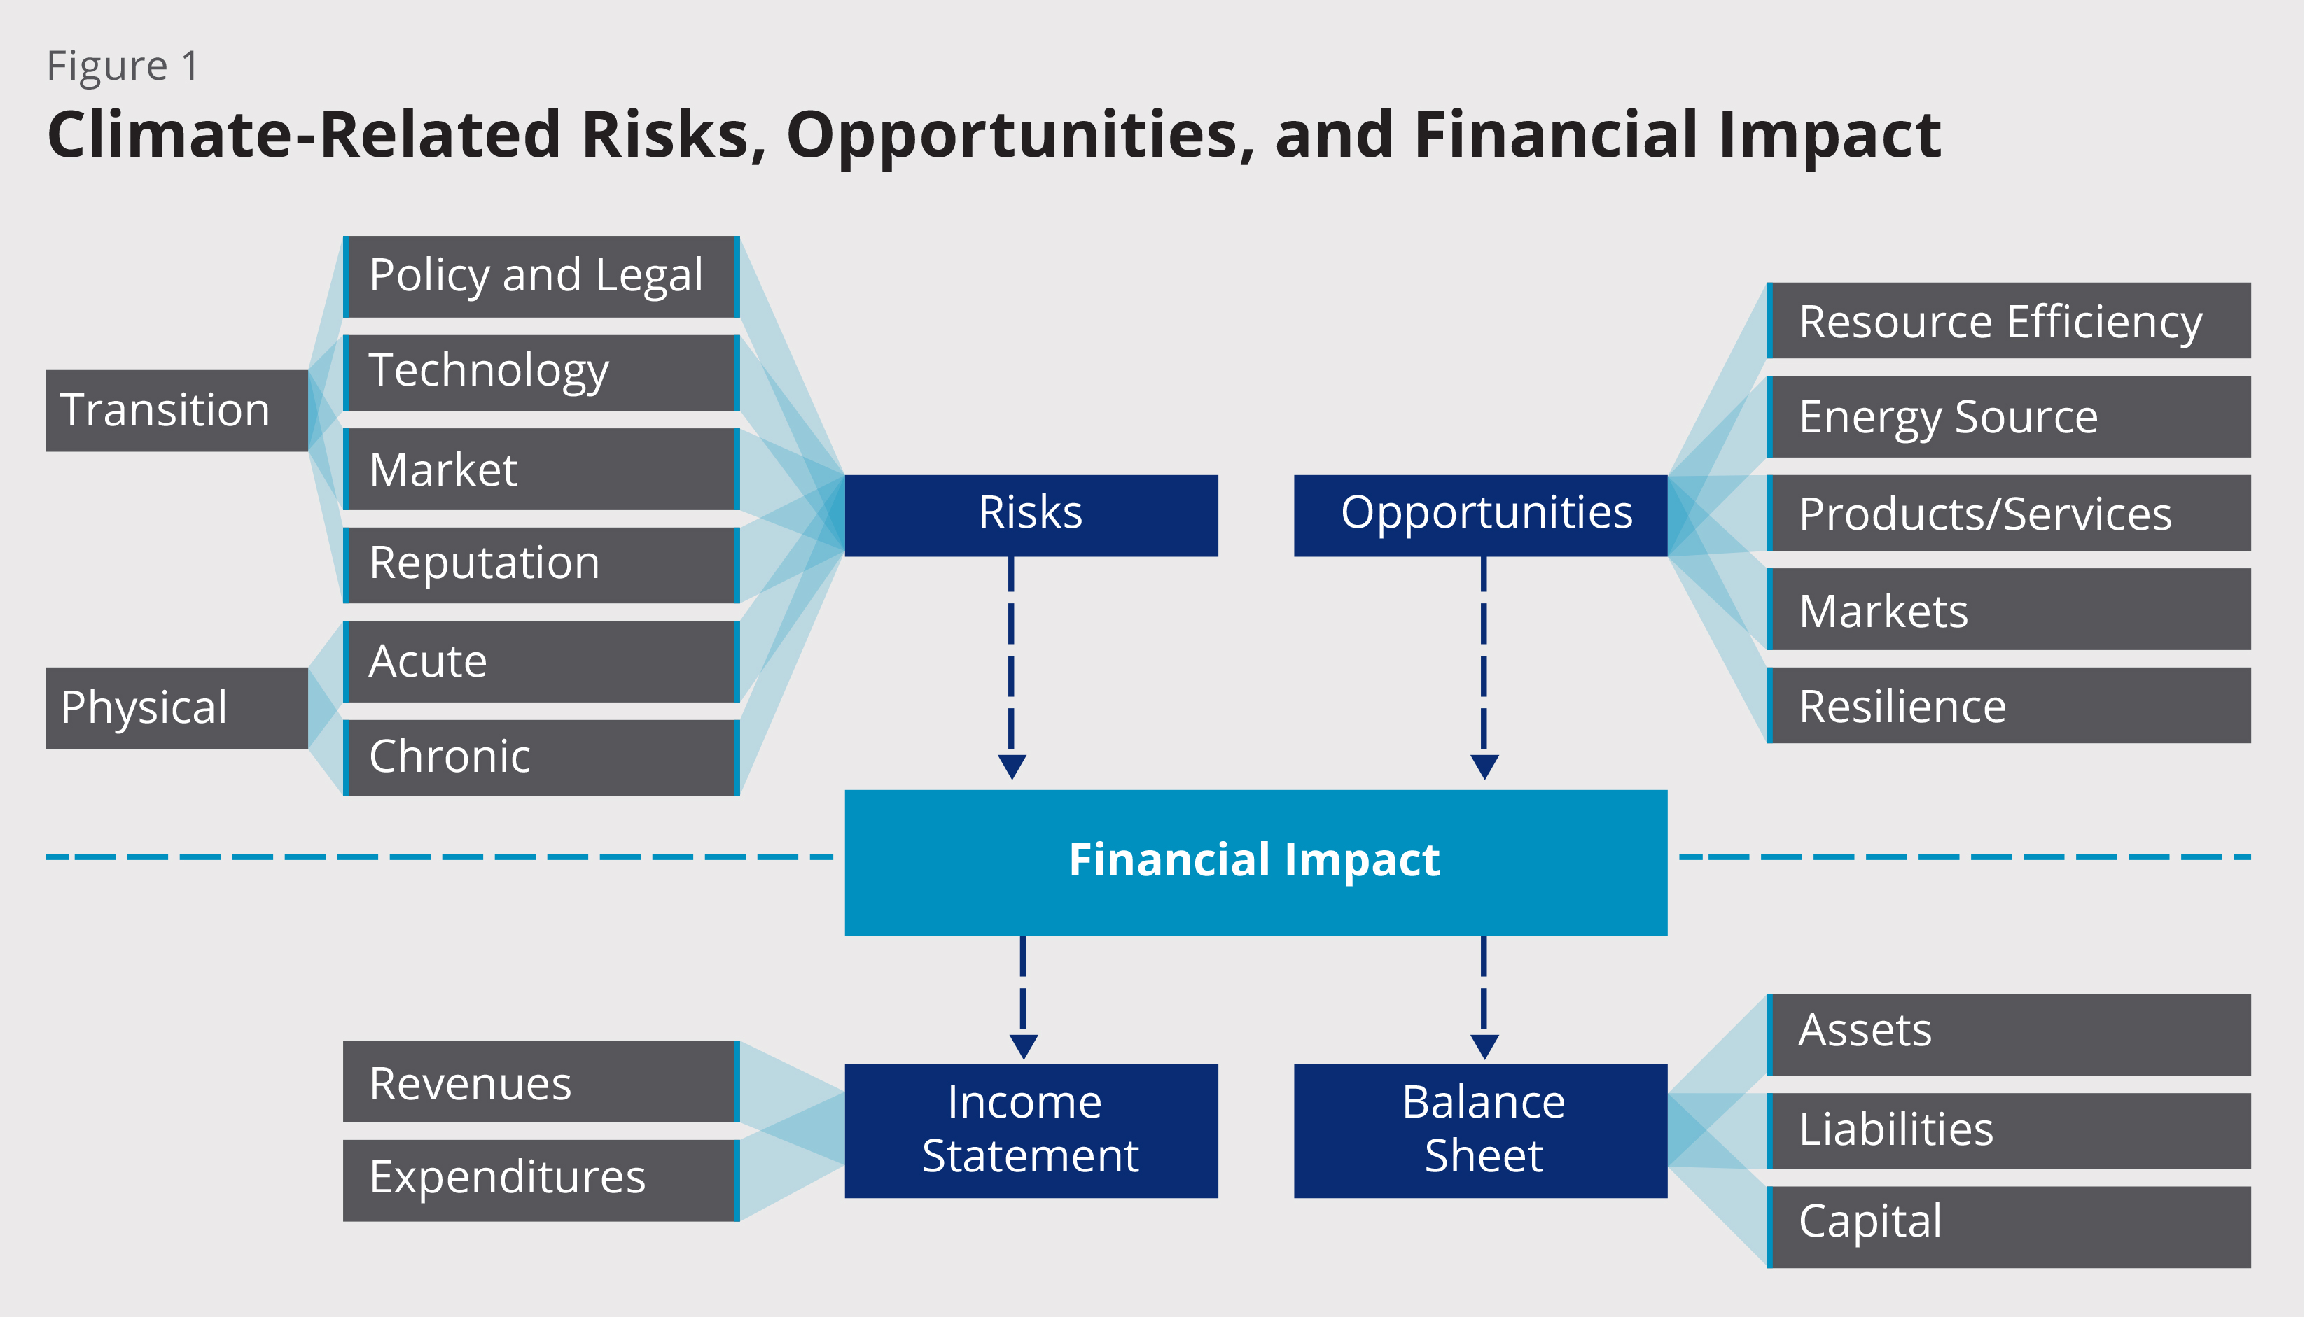
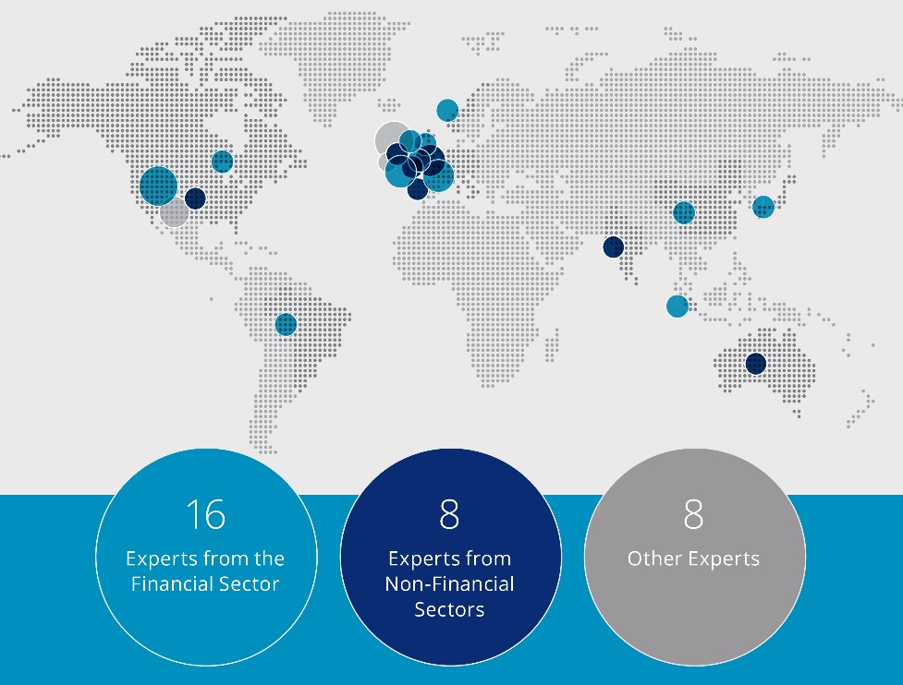
Task Force for Climate-related Financial Disclosure - Background
G20 Finance Ministers and Central Bank Governors asked the Financial Stability Board (FSB) to review how the financial sector can take account of climate-related issues.
The FSB established the Task Force on Climate-related Financial Disclosures (TCFD) to develop recommendations that:
could “promote more informed investment, credit, and insurance underwriting decisions” and,
in turn, “would enable stakeholders to understand better the concentrations of carbon-related assets in the financial sector and the financial system’s exposures to climate-related risks.”
*
Industry Led and Geographically Diverse Task Force
  The Task Force’s 31 international members, led by Michael Bloomberg, include providers of capital, insurers, large non-financial companies, accounting and consulting firms, and credit rating agencies.
13
9
9

Slide 14
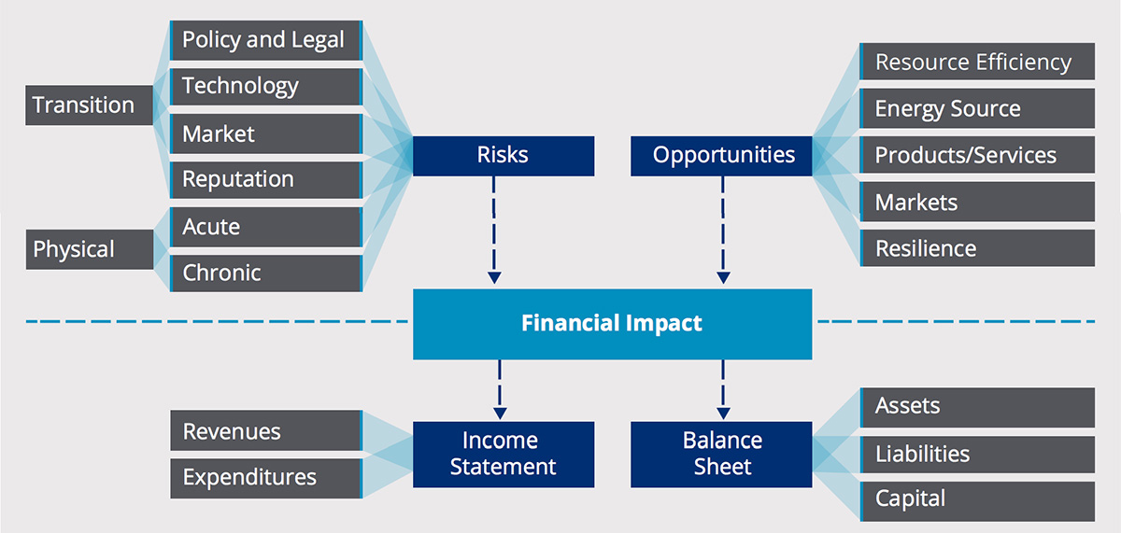
Task Force for Climate-related Financial Disclosure (TCFD) - Taxonomy
TCFD – Focus on Financial Impacts

Slide 15
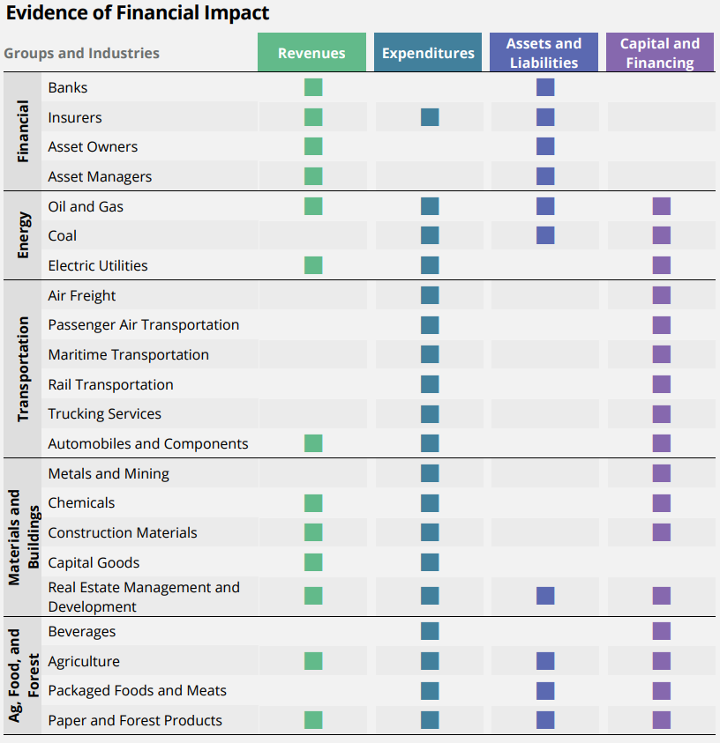
Financial Impact by Industry
To assist organizations in understanding how climate-related risks may impact them financially, the Task Force prepared a high-level overview of the types of financial impact of climate-related risks that have been identified for specific industries and groups.
The financial impacts from climate-related risks are grouped into the following general categories:
Revenues
Expenditures
Assets and Liabilities
Capital and Financing
*
© 2019 Deloitte Conseil
*Largely, but not solely, based on select content from the Sustainability Accounting Standards Board (SASB) “Financial Impacts of Climate Risk” table in its Climate Risk Technical Bulletin

Slide 16
Structure of TCFD recommendations
The Task Force developed four widely-adoptable recommendations on climate-related financial disclosures that are applicable to organizations across sectors and jurisdictions.
The recommendations are structured around four thematic areas that represent core elements of how organizations operate:
Governance
The organization’s governance around climate-related risks and opportunities
Governance
Strategy
Strategy
The actual and potential impacts of climate-related risks and opportunities on the organization’s businesses, strategy, and financial planning
Risk
Management
Risk Management
The processes used by the organization to identify, assess, and manage climate-related risks
Metrics
and
Targets
Metrics and Targets
The metrics and targets used to assess and manage relevant climate-related risks and opportunities

Slide 17
TCFD - Latest
TCFD by
the numbers
2018 Status Report
*
The majority disclose some
climate-related information.
601
Supporters as of March 2019
Information on strategy resilience under climate-related scenarios is limited.
Disclosures are often made
in multiple reports.
With a market capitalisation of over 8.7 trillion USD.
Including 326 financial firms, responsible for assets of over 107 trillion USD.
Financial implications are often not disclosed.
Disclosures vary across industries and regions.
For example a higher percentage of non-financial companies reported information on their climate related metrics and targets compared to financial companies, but a higher percentage of financial companies indicated their enterprise risk management process included climate-related risk.

Slide 18
Closing remarks

Slide 19
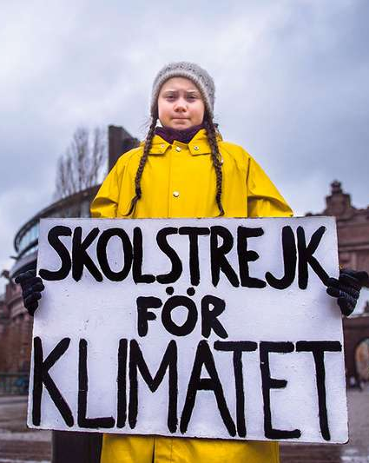
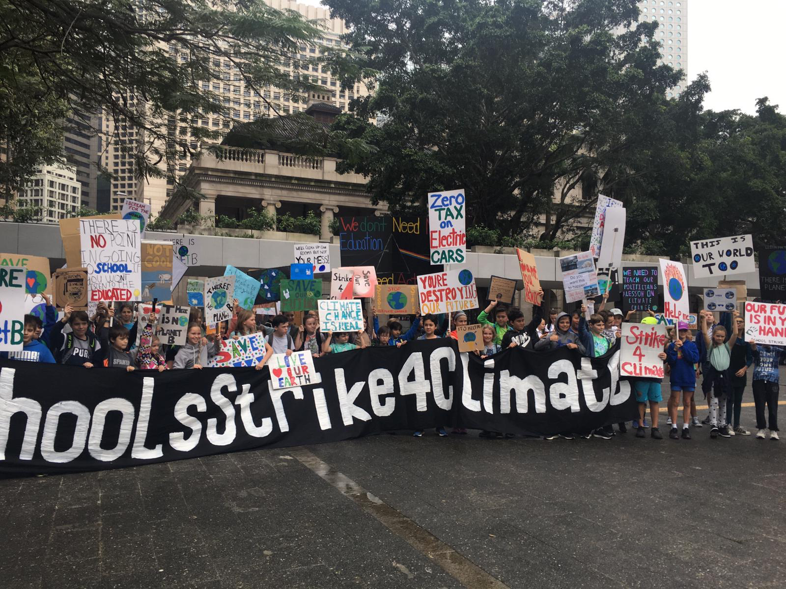
Closing remarks
“Attracting and retaining the best talent increasingly requires a clear expression of purpose… In a recent survey by Deloitte, millennial workers were asked what the primary purpose of businesses should be – 63 percent more of them said ‘improving society’ than said ‘generating profit.’” – Blackrock Chairman and CEO, Larry Fink, 2019 Letter to CEOs

Slide 20
About Deloitte Global
Deloitte refers to one or more of Deloitte Touche Tohmatsu Limited, a UK private company limited by guarantee ("DTTL"), its network of member firms, and their related entities. DTTL and each of its member firms are legally separate and independent entities. DTTL (also referred to as "Deloitte Global") does not provide services to clients. Please see www.deloitte.com/about for a more detailed description of DTTL and its member firms.
Deloitte provides audit, consulting, financial advisory, risk management, tax and related services to public and private clients spanning multiple industries. Deloitte serves four out of five Fortune Global 500® companies through a globally connected network of member firms in more than 150 countries bringing world-class capabilities, insights, and high-quality service to address clients’ most complex business challenges. To learn more about how Deloitte’s approximately 225,000 professionals make an impact that matters, please connect with us on Facebook, LinkedIn, or Twitter.
About Deloitte in Greater China
We are one of the leading professional services providers with 24 offices in Beijing, Hong Kong, Shanghai, Taipei, Changsha, Chengdu, Chongqing, Dalian, Guangzhou, Hangzhou, Harbin, Hefei, Hsinchu, Jinan, Kaohsiung, Macau, Nanjing, Shenzhen, Suzhou, Taichung, Tainan, Tianjin, Wuhan and Xiamen in Greater China. We have nearly 13,500 people working on a collaborative basis to serve clients, subject to local applicable laws.
About Deloitte China
The Deloitte brand first came to China in 1917 when a Deloitte office was opened in Shanghai. Now the Deloitte China network of firms, backed by the global Deloitte network, deliver a full range of audit, tax, consulting and financial advisory services to local, multinational and growth enterprise clients in China. We have considerable experience in China and have been a significant contributor to the development of China's accounting standards, taxation system and local professional accountants. To learn more about how Deloitte makes an impact that matters in the China marketplace, please connect with our Deloitte China social media platforms via www2.deloitte.com/cn/en/social-media.
This communication contains general information only, and none of Deloitte Touche Tohmatsu Limited, its member firms, or their related entities (collectively the "Deloitte Network") is by means of this communication, rendering professional advice or services. None of the Deloitte Network shall be responsible for any loss whatsoever sustained by any person who relies on this communication.
©2019. For information, contact Deloitte Advisory (Hong Kong) Limited

